Slide 1
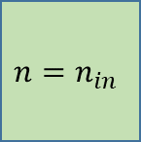


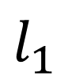

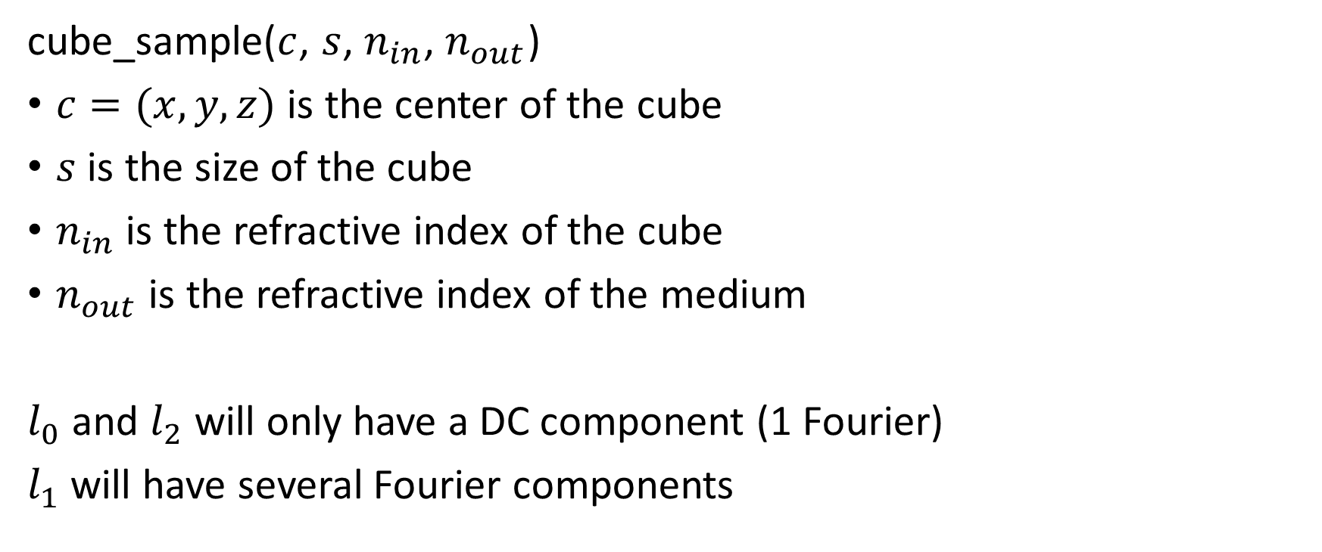


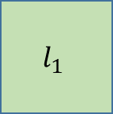



Cube Samples
$$x$$
$$l_{0}$$
$$l_{1}$$
$$z$$
$$s$$
cube_sample($c$, $s$, $n_{in}$, $n_{out}$)
$c=(x,y,z)$ is the center of the cube
$s$ is the size of the cube
$n_{in}$ is the refractive index of the cube
$n_{out}$ is the refractive index of the medium
$l_{0}$ and $l_{2}$ will only have a DC component (1 Fourier)
$l_{1}$ will have several Fourier components
$$l_{2}$$
$$l_{1}$$
$$x$$
$$n=n_{out}$$
$$n=n_{in}$$
$$y$$

Slide 2

Rectangle Bar Samples
$$s$$
rectangle_bar_sample($⋯$)

